Slide 1
United States Constitution
The 1st Amendment

Slide 2
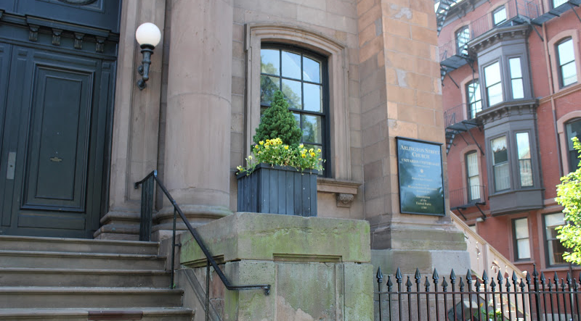
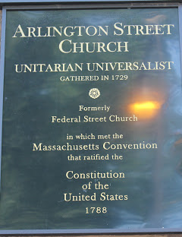
The Constitution was created on September 17 in 1787.
It was ratified on June 21, 1788 in what is now the Unitarian Universalist Church on the edge of the Boston.

Slide 3
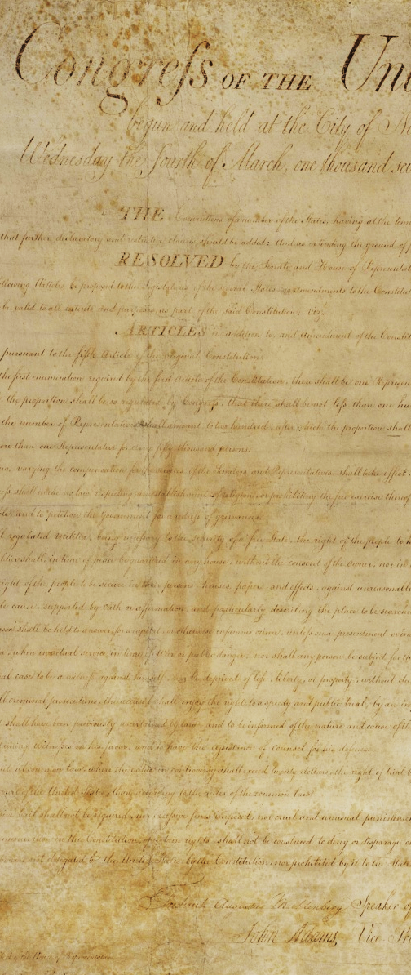
The original Constitution did not have a Bill of Rights.
James Madison drafted the Bill of Rights in 1789 and it was adopted by the states in 1791.
The Bill of Rights was created because our country’s founding leaders were afraid the government would have too much power. These new American citizens wanted to be certain that particular, important rights were explicitly stated and protected.

Slide 4
Thomas Jefferson was one of those founding leaders. He believed governments do not give rights to people, but rather have the responsibility to protect the rights that all people have naturally.
They call his school of thought "Enlightenment".

Slide 5
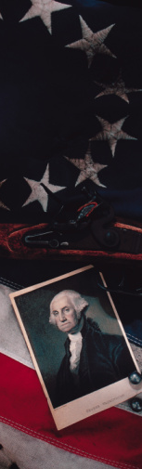
Q: Why were our country’s founding fathers worried about whether the government had too much power?
A: Because the United States just finished fighting England for our independence. The Americans were protesting the King of England’s strict control over the colonies. Americans wanted to make sure that no government held that kind of control over them again.

Slide 6
The First Amendment to the
U.S. Constitution states:
"Congress shall make no law respecting an establishment of religion, or prohibiting the free exercise thereof; or abridging the freedom of speech, or of the press; or the right of the people peaceably to assemble, and to petition the government for a redress of grievances."

Slide 7
The First Amendment protects Americans’ rights to believe what they want to believe and say what they think, except in limited circumstances. It contains the most basic of all individual freedoms: Religion, Speech, Press, Assembly and Petition. These are often referred to as “the first five freedoms.”

Slide 8
Taken together, these 5 freedoms constitute the cornerstone of our democracy.
Free speech deserves Constitutional protection because it serves 3 purposes:
It advances knowledge and the ascertainment of truth,
Facilitates self-government in a democracy, and
Promotes individual autonomy, self-expression and self-fulfillment.

Slide 9
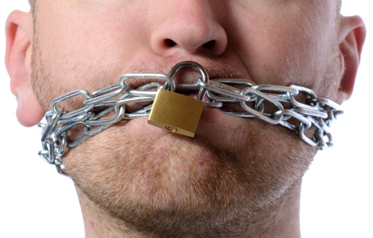
Q: What are the five rights, or freedoms, set forth by the First Amendment? Can you pick them out?
A: The five freedoms are: Freedom of Religion, Freedom of Speech, Freedom of the Press, Freedom of Assembly and Freedom to Petition the Government. These are often referred to as “the first five freedoms.”
            The First Amendment protects Americans’ rights to believe what they want to believe and say what they think, except in limited circumstances.
            Taken together, these five freedoms constitute the cornerstone of our democracy.

Slide 10

Speech under the First Amendment
Q: What is speech? What different types of communication might qualify as speech under the First Amendment?
A: Speech is any form of communication including:
Verbal communication
Actions, i.e. protesting by picketing
with signs
Written words
Art & Literature (painting, singing, dance)

Slide 11

Q: Why as Americans are we given the right to free speech? How does it benefit us?
A: Free speech deserves Constitutional protection because it serves 3 purposes:
  It helps us learn things and to find out the truth about things
  It helps us govern ourselves in a democracy, and
  It lets us be unique individuals who can express ourselves how we want

Slide 12
CRITICAL POINT:
Only the government can violate the First Amendment.
Limitations placed on speech by Facebook, Twitter, Google or a private employer, no matter how restrictive, do not violate the First Amendment because those restrictions are not made by the government.

Slide 13
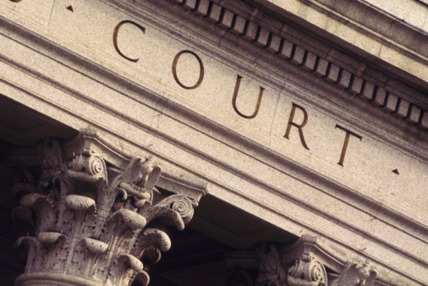
Q: Can you think of 5 different types of “government?”
Courts,
police,
public officials,
public school employees,
city council,
FBI.

Slide 14
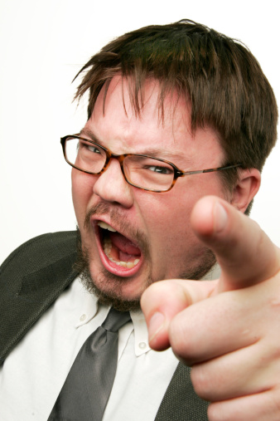
Protected vs. Unprotected Speech
NOT ALL speech is protected.
Q: Can you think of reasons why some kinds of speech might not be protected?
  Safety of the public
  The need for government to administer other laws
Q: Can you think of ways people can get in trouble for telling lies or creating safety issues with their speech?
  Defamation (harming others by lying about them)
  Disturbing the peace
  Inciting a riot
  Causing a stampede by yelling “fire” in a crowded theater

Slide 15
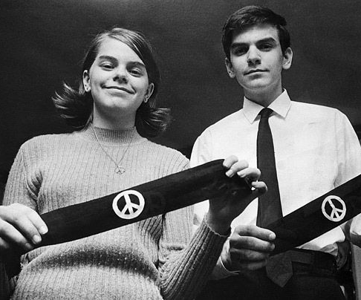
Tinker v. DesMoines Independent Community School District,
393 US 503 (1969)
Three siblings, John Tinker, 15, Mary Beth Tinker, 13, and Christopher Eckhardt, 16, years old, wore black arm bands to school to demonstrate their objection to the Vietnam War in the 1960s and to show their support for a truce. The boys both attended high schools and the girl attended junior high school.
The students wore black armbands to their schools and were all sent home and suspended from school until they would come back without their armbands. They did not return to school until after the planned period for wearing armbands had expired.

Slide 16
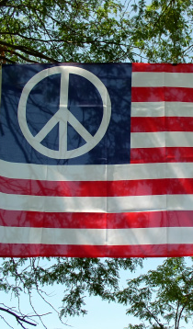
The students and their parents sued the school for violating their First Amendment rights to free speech. The case went all the way to the U.S. Supreme Court.
Q: What kind of speech did the students express?
A: Political speech gets the highest protection.

Slide 17
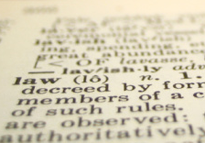
The Supreme Court held in favor of the students. They said students cannot be punished for expressing their personal views, even on controversial matters, on the school premises. Students have the right to speak about political issues …..

Slide 18
HOWEVER, the school can ban even political speech if it “materially and substantially disrupts the operation of the school or collides with the rights of other students.”
The school does not have to wait until a disruption occurs.
If school authorities can predict a substantial disruption of school activities it can ban the speech.

Slide 19
Protected by the
First Amendment
or Not Protected?
RAPID FIRE DECISIONS!
NO MORE THAN
2 MINUTES PER CASE!

Slide 20
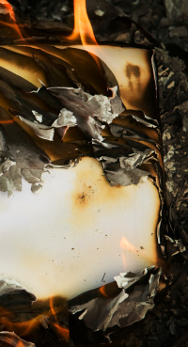
Case 1:
In the 1960s, men had to serve in the United States Army. They were sent “draft cards” in the mail telling them when to report for military duty. The cards had numbers on them that helped the government keep track of its army.
Many men didn’t want to serve in the Army. They burned their draft cards as an expression of their protest against the war and serving in the military.
Do you think burning a draft card was protected speech or not protected?

Slide 21
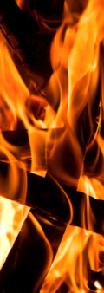
Case 2:
During the civil rights movement of the 1960s, members of the Ku Klux Klan would sometimes burn crosses.
Do you think it is legal for the government to outlaw burning crosses?
What might the answer depend on?

Slide 22
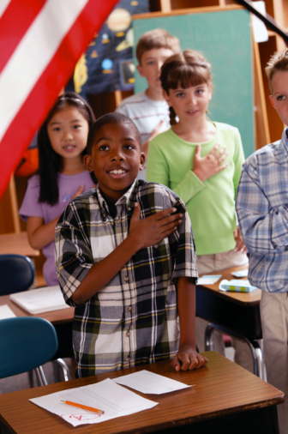
Case 3:
Your classmate refuses to say the Pledge of Allegiance in a public school because it uses the word “God” and he does not believe in God?
Do you think he can be forced to say the Pledge?

Slide 23
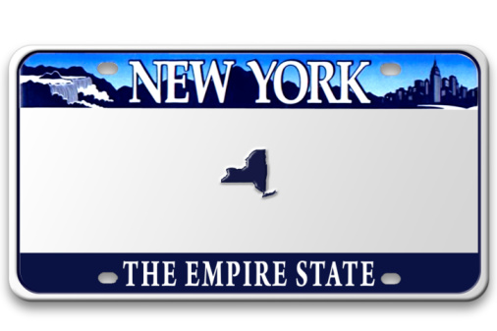
Case 4:
You just bought your first car and you go to the Secretary of State and get a license plate. It says on it, “Live Free or Die.” You hate that. You put duct tape over it.
Can the police arrest you, or is your symbolic speech protected?

Slide 24

Case 5:
The head of the Cancer Awareness Club has passed out a bunch of stretchy bracelets that say “ ♥ Boobies”.
Do you believe the school had the right to ban the bracelets?

Slide 25

Case 6:
You have had a bad year with one of your teachers. You go on your FaceBook page and you write, “Ms. ________ is the worst teacher I’ve ever met. To those students who have had the displeasure of having Ms. ________, or simply knowing her and her insane antics; Here is the place to express your feelings of hatred.”

Slide 26
Case 6:
Peter Bayer, the principal of Pembroke Pines High, suspended Evans for three days and removed her from her Advanced Placement classes for violating the school's rules against "cyberbullying" and "harassment" of a staff member, according to court documents.

Slide 27
Case 6:
Can the school suspend you for putting that on your FaceBook page?
Can the school suspend students for “Liking” that posting?

Slide 28

Case 7:
Your friends pick up on the idea of criticizing teachers on FaceBook and one of them starts using vulgar language about a teacher and asks fellow students to help him raise money “to help pay for a hit man.”
A picture of the teacher with her head cut off is posted. The teacher is so emotionally distraught she takes a one-year medical leave of absence and the student is suspended for 10 days.
Can the school do that?

Slide 29
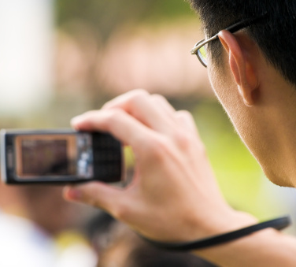
Case 8:
The Class Clown decides to take some video footage on his i-phone of the gym teacher bending over and while the student stood behind her making vulgar motions and dubbed in the song “Ms. New Booty.” The student was suspended for 40 days.
Can the school do that?

Slide 30
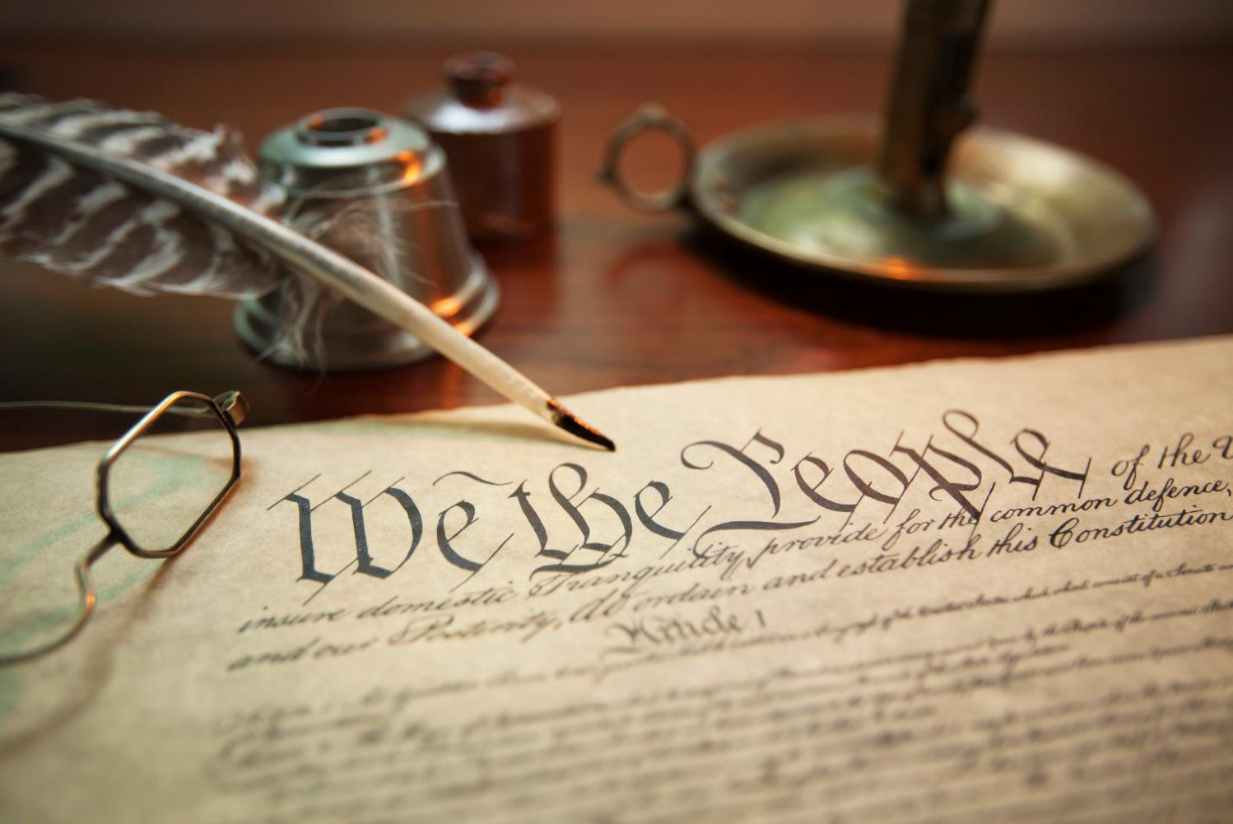
Constitution Day September 17
Constitution Day reminds us of our important protections and rights under law.
Notes:
Under the laws created and voted upon by the people of the United States of America.

